Slide 1
Team 10 Restaurant Database Management App
Sorin Olteanu, Ben Griffiths, Diego Tolerado, Gunjan Sahityani,
Junaid Alam, Lorenzo Menegotto, Uyi Fitzpatrick

Slide 2
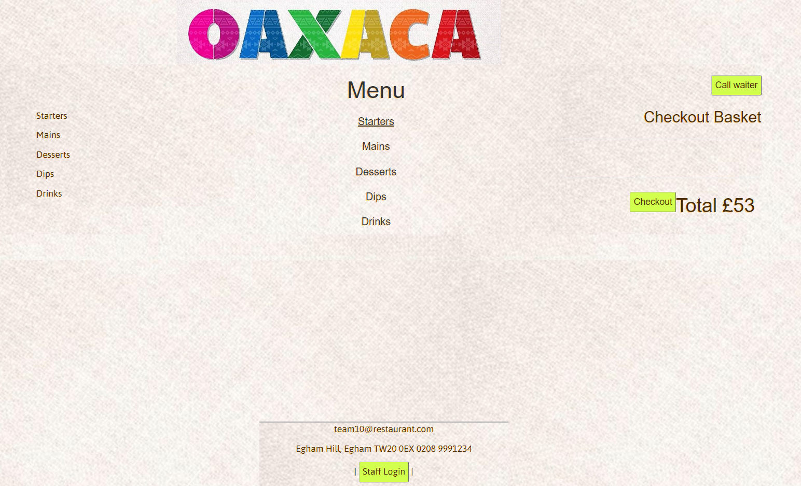
Home Page - Menu

Slide 3
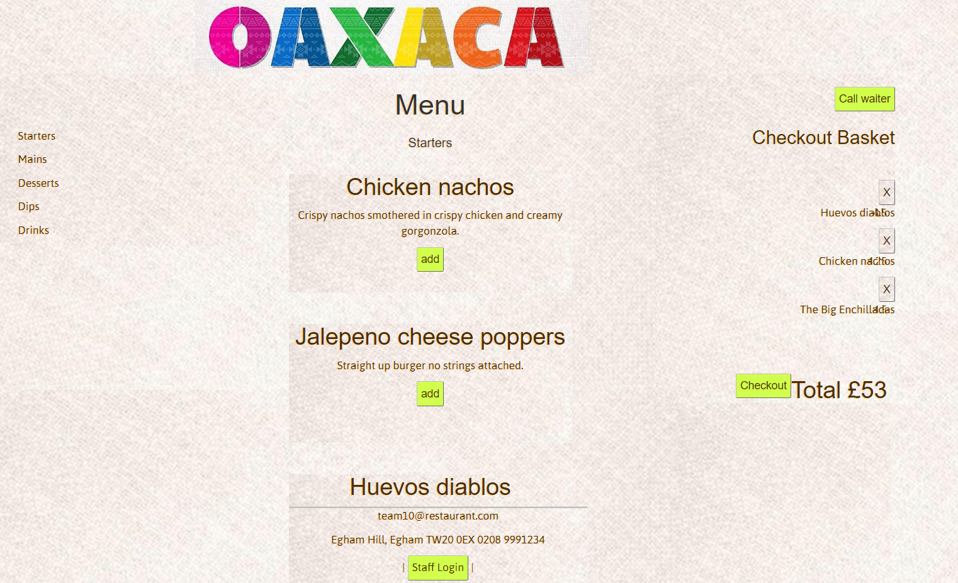
Menu – Add to Basket
[shortcuts]
[more items further down the page]

Slide 4
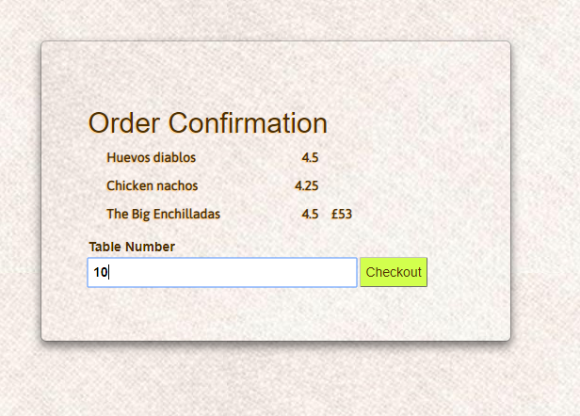
Menu - Checkout

Slide 5
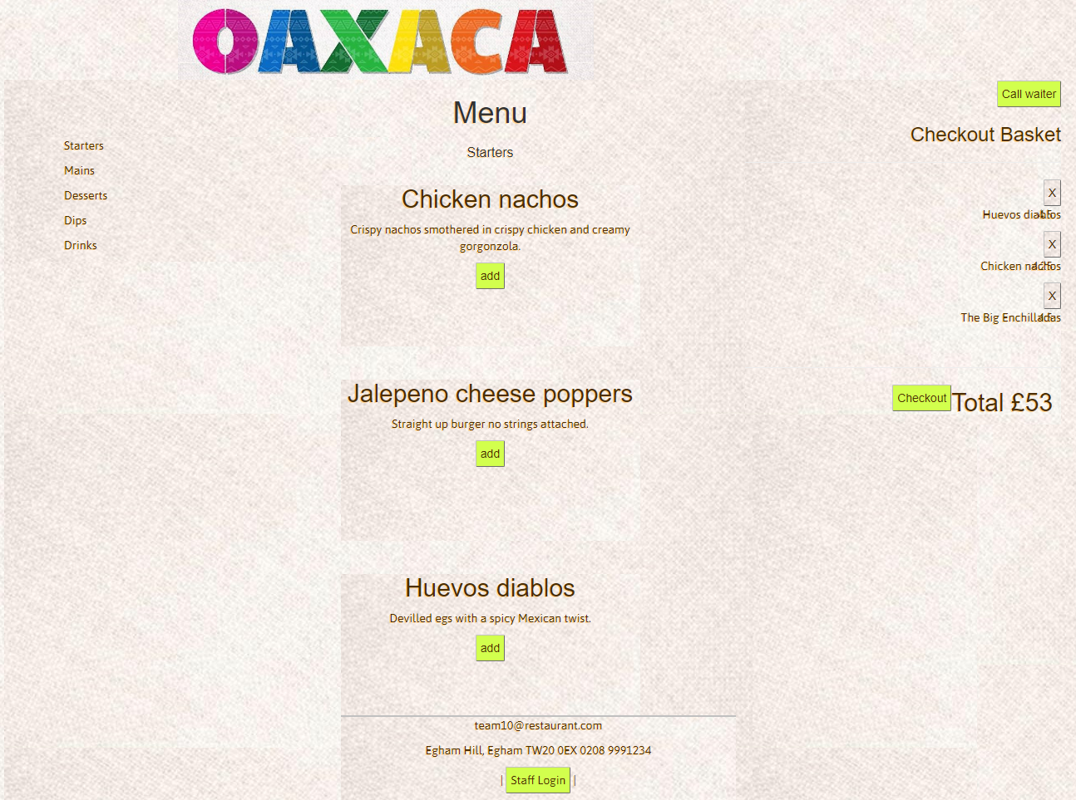
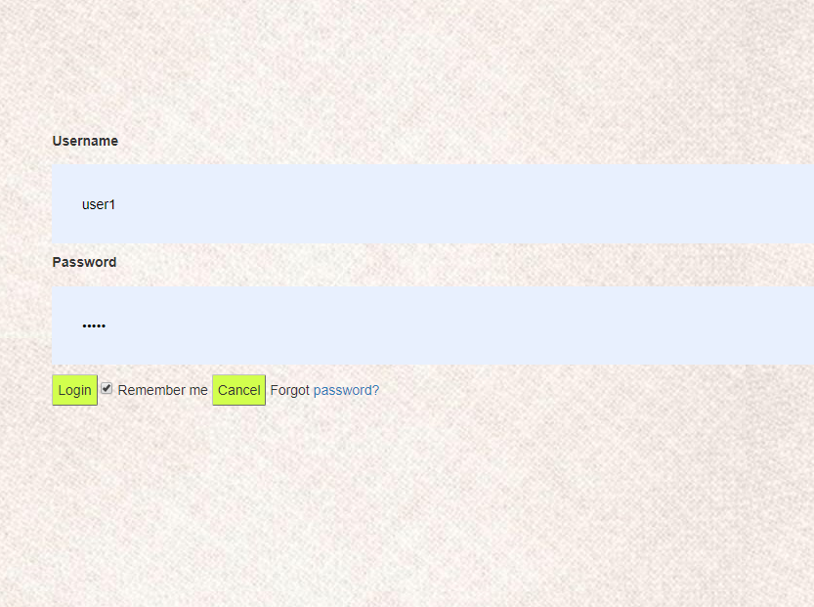
Staff – Log In

Slide 6
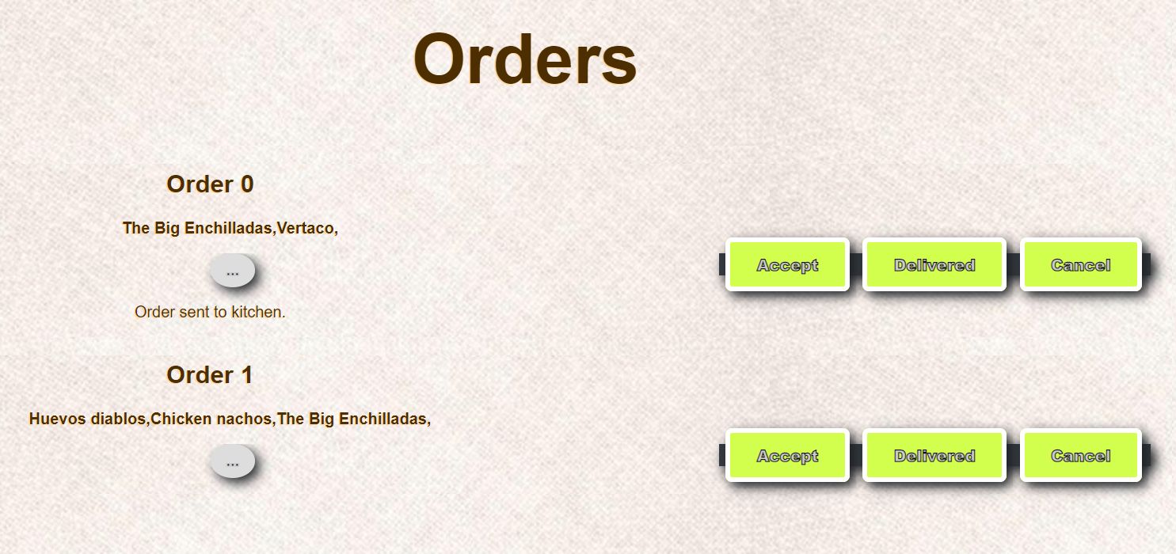
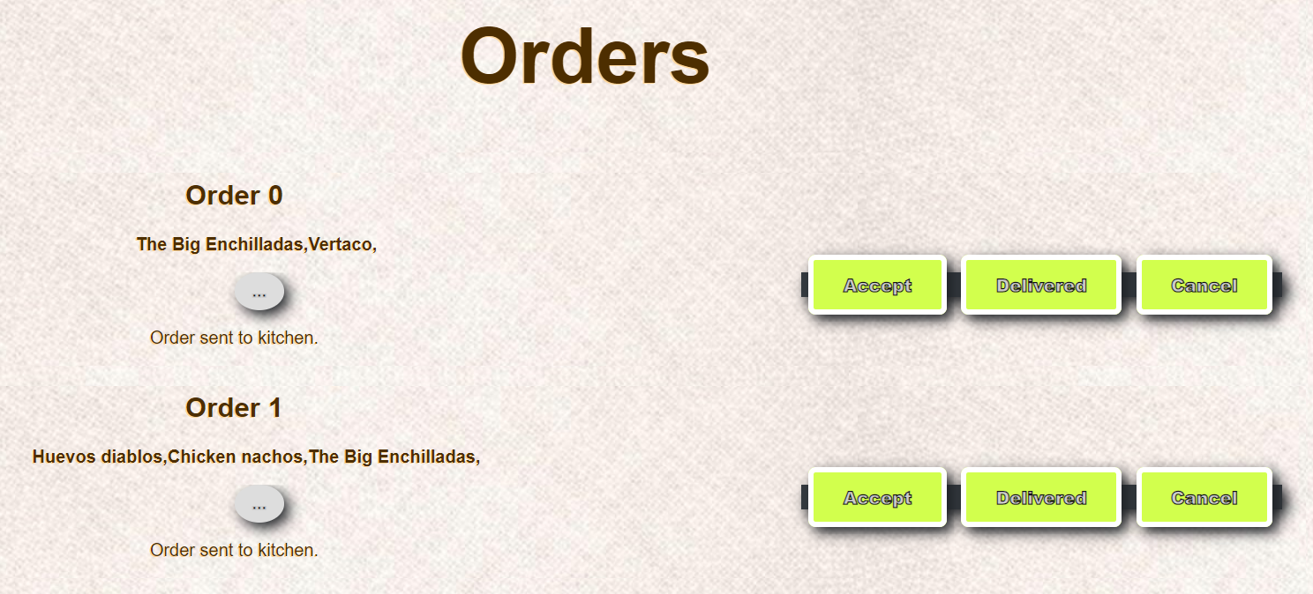
Waiter Screen – Accept Order

Slide 7
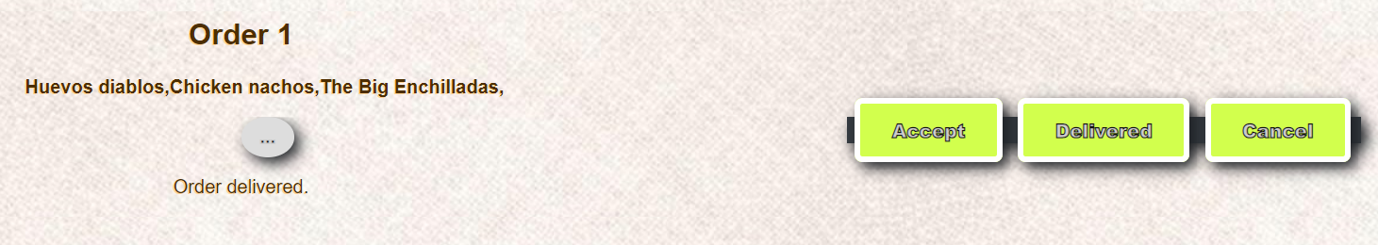
Waiter Screen – Set Ordered - Delivered

Slide 8
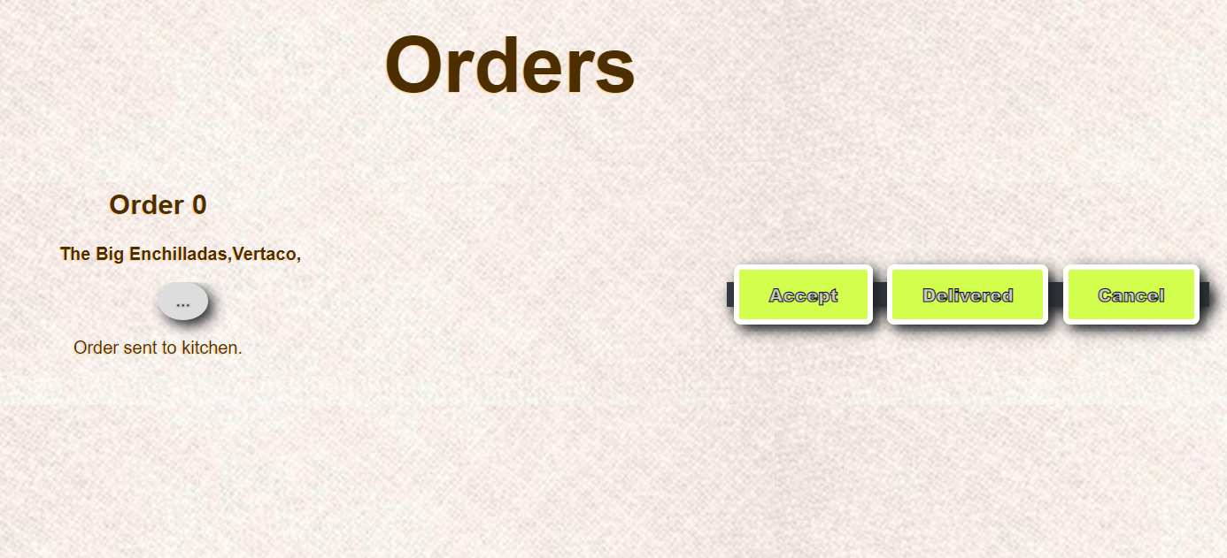
Waiter Screen – Cancel Order

Slide 9
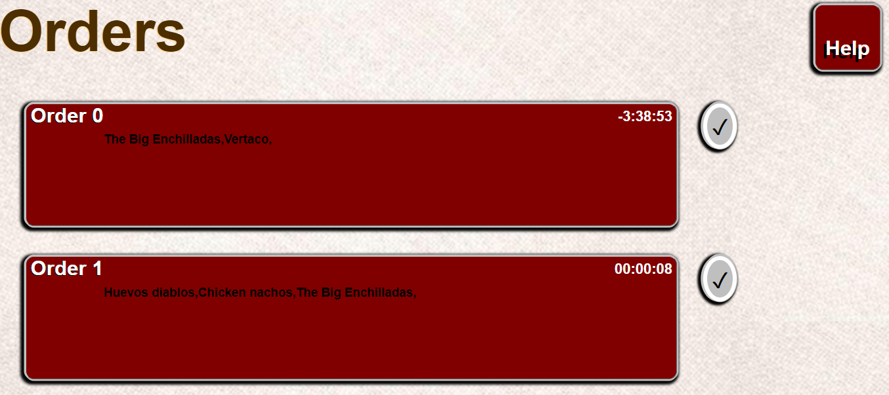
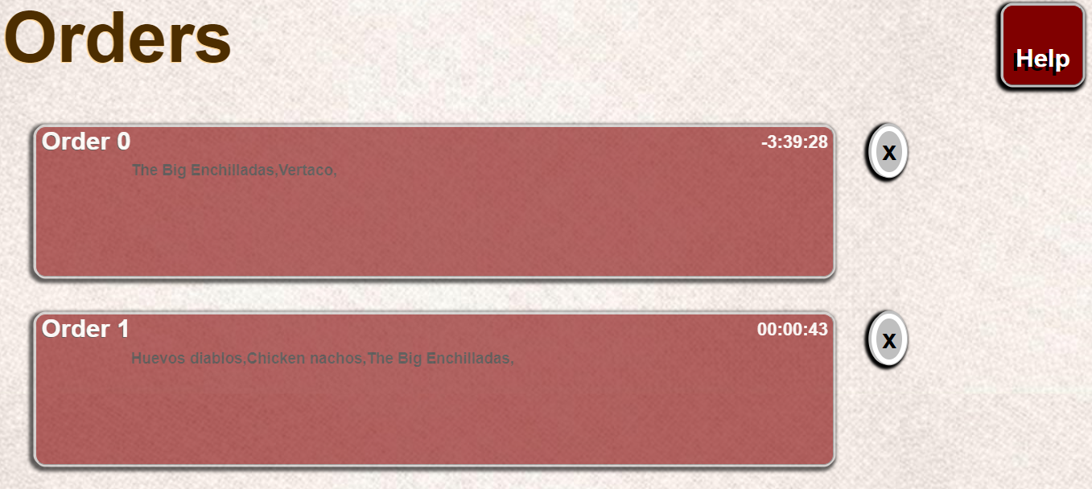
Kitchen Screen – Accept/Undo Accept

Slide 10
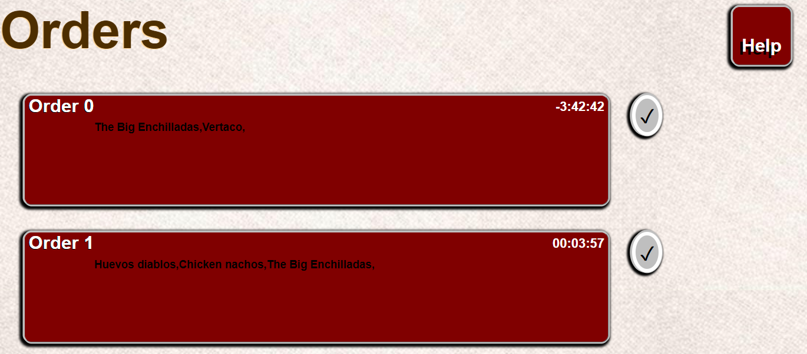
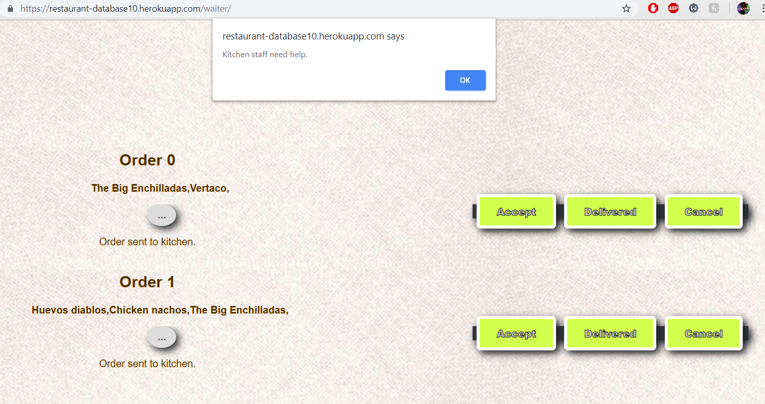
Kitchen Screen – Ask for Help

